Slide 1
GROUP 15: DESIGN OF ROAD SIGN AND ROAD STATE MOBILE NOTIFICATION APPLICATION
TASK 3: REQUIREMENT GATHERING ANALYSIS

Slide 2
GROUP MEMBERS
NAME | MATRICULE NUMBER | SPECIALTY
AZEFACK JUNIOR | FE21A146 | NE
BESONG ELIAS ASUMU | FE21A149 | SE
KANKO KAMEDJEU DUPLEX | FE21A210 | NE
KENEDY MALLEY ITUKA | FE21A212 | NE
KONGYUY RAYMOD AFONI | FE21A219 | NE

Slide 3
OUTLINE
01
INTRODUCTION
02
REVIEW AND ANALYSIS OF GATHERED REQUIREMENTS
03
IDENTIFYING INCONSISTENCIES, AMBIGUITIES AND MISSING INFORMATION
04
PRIORITIZING REQUIREMENTS BASED ON IMPORTANCE AND FEASIBILITY
05
REQUIREMENT VALIDATION INVOLVING STAKE HOLDERS
06
DOCUMENTATION OF FINAL REFINED REQUIREMENTS
07
CONCLUSION

Slide 4
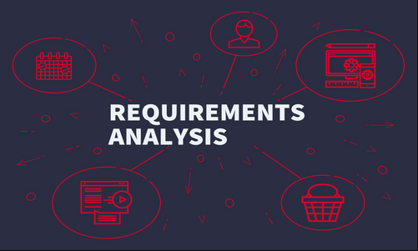
INTRODUCTION
Requirements Analysis is the heart of a successful software development project. It's where you take the raw desires and needs (gathered requirements) and transform them into a clear, actionable roadmap for development
The analysis is based on the information provided in the requirements gathering document and focuses on ensuring the application delivers a safe and user-friendly experience.

Slide 5



REVIEW AND ANALYSIS OF GATHERED REQUIREMENTS
This initial step involves a thorough examination of the information collected during the requirements gathering phase. The goal is to ensure:
Completeness
Clarity
Technical Feasibility
Understand the "why" behind the "what"
Identify dependencies and relationships

Slide 6


IDENTIFYING INCONSISTENCIES, AMBIGUITIES AND MISSING INFORMATION
This step focuses on identifying any gaps or unclear details within the requirements that could hinder development.
They include:
Inconsistencies
Ambiguities
Missing Information
User Profiles

Slide 7
PRIORITIZING REQUIREMENTS BASED ON IMPORTANCE AND FEASIBILITY
We will utilize a prioritization matrix to categorize the requirements for the Road Sign App. This ensures critical features for user safety (e.g., real-time sign recognition) are designated as "Must-Have," while less essential but valuable features (e.g., AR navigation) might be "Consider Later" depending on technical limitations.
Importance | High | Medium | Low
High Feasibility | Must-Have | Should-Have | Consider Later
Medium Feasibility | Should-Have | Consider Later | May Not Include
Low Feasibility | Consider Later | May Not Include | Not Included

Slide 8

REQUIREMENT VALIDATION INVOLVING STAKE HOLDERS
This step involves getting feedback and refining the requirements through discussions with key stakeholders. Aims here are;
Ensure everyone is on the same page
Address concerns and clarifications

Slide 9

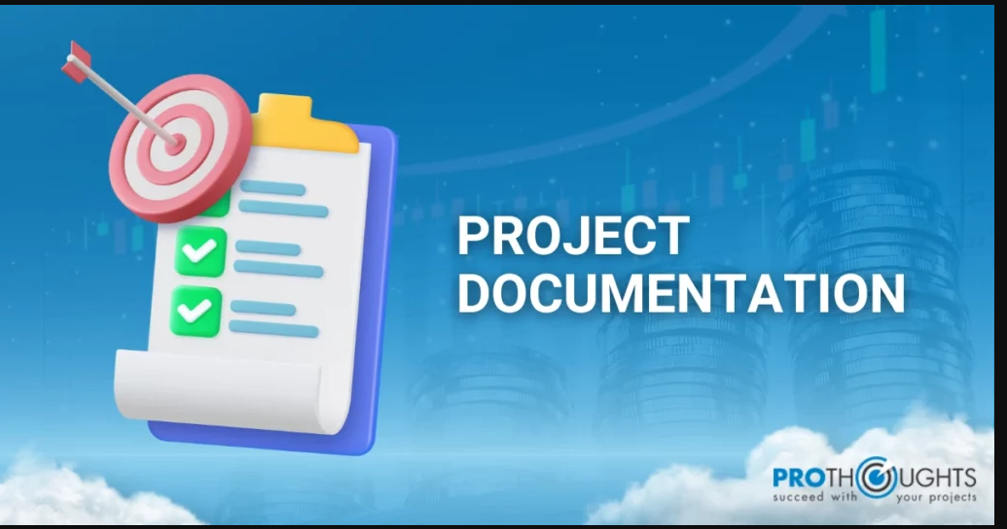
This final step involves creating a clear and concise requirements document incorporating the insights from stakeholder validation. Using standardized format: This that ensures everyone understands the structure and terminology used and maintaining the document throughout the project as requirements evolve, the document is updated to reflect the latest agreed-upon state

Slide 10
Based on the analysis of user needs and project goals, we have identified the following functional requirements to enhance the application's capabilities:
1. Real-time Road Sign Recognition:
The application will leverage computer vision techniques to identify and display relevant road sign information overlaid directly onto the user's view of the road using the device's camera
2. Location-Aware Information and Navigation:
i. Location-based Information:
The application will use GPS to determine the user's location and display relevant road sign information overlaid on a map. This map integration will allow users to visualize their surroundings and road sign placements.
ii. Real-time Road State Updates:
iii. Interactive Maps:
iv. Navigation Integration (Optional):
v. Augmented Reality Navigation (Optional):
3. Traffic Light and Sign Detection:
4. Pedestrian Detection (Optional):
5. User Reporting:
6. Route Planning:
7. User Profiles:
Users should be able to create profiles, customize their preferences, and save frequently used routes for quick access.
NON-FUNCTIONAL REQUIREMENTS:
Building upon the provided information, here's a revised and enhanced list of non-functional requirements for the mobile application:
1. Reliability:
➢ Accurate Navigation Information & user location.
➢ Minimized Interruptions:
2. Performance:
➢ Real-time Processing:
➢ Touch Screen Responsiveness:
➢ Efficient Mobile Performance:
3. Usability:
➢ Broad User Accessibility:
➢ Simple and Responsive Interface:
➢ Minimized Driver Distraction
4. Security and Privacy:
➢ Data Protection:
➢ Data Encryption:
➢ Modular Design:
FUNCTIONAL REQUIREMENTS:
Based on the analysis of user needs and project goals, we have identified the following functional requirements to enhance the application's capabilities:
1. Real-time Road Sign Recognition:
Location-Aware Information and Navigation:
i. Location-based Information:
ii. Real-time Road State Updates:
The application should provide real-time information about road conditions, including traffic congestion, accidents, construction work, and road closures.
iii. Interactive Maps:
Users should be able to view road conditions on interactive maps, with options to zoom in, switch between different map views (e.g., satellite, terrain), and search for specific locations.
Augmented Reality Navigation (Optional):
3. Traffic Light and Sign Detection:
4. Pedestrian Detection (Optional):

Slide 11
NON-FUNCTIONAL REQUIREMENTS:
Building upon the provided information, here's a revised and enhanced list of non-functional requirements for the mobile application:
1. Reliability:
➢ Accurate Navigation Information & user location.
➢ Minimized Interruptions:
2. Performance:
➢ Real-time Processing:
➢ Touch Screen Responsiveness:
➢ Efficient Mobile Performance:
3. Usability:
➢ Broad User Accessibility:
➢ Simple and Responsive Interface:
➢ Minimized Driver Distraction
4. Security and Privacy:
➢ Data Protection:
➢ Data Encryption:
➢ Modular Design

Slide 12
CONCLUSION
A thorough requirements analysis ensures the Road Sign and Road State Mobile Notification Application addresses user needs, prioritizes critical features for safety, and leverages technology effectively
By following these recommendations and building upon the comprehensive requirements analysis, we can develop a Road Sign and Road State Mobile Notification Application that empowers drivers in Buea with real-time information, enhances road safety, and provides a valuable tool for navigating the city's unique roads.

